Slide 1

Blockchain Brigade
Bootcamp vs. Traditional Computer Science Degrees

Slide 2

Overview
Data Science Bootcamp vs Traditional Data Science Degree
In today’s job market it is imperative for you to ensure your credentials are marketable and can appeal to multiple industries. Technology is continuously evolving, and you may have noticed an increased trend in Data Science Bootcamps being offered.
In this project we will develop a data analysis to determine the educational and financial benefit of obtaining data science credentials from completing a bootcamp vs getting a traditional data science degree.

Slide 3
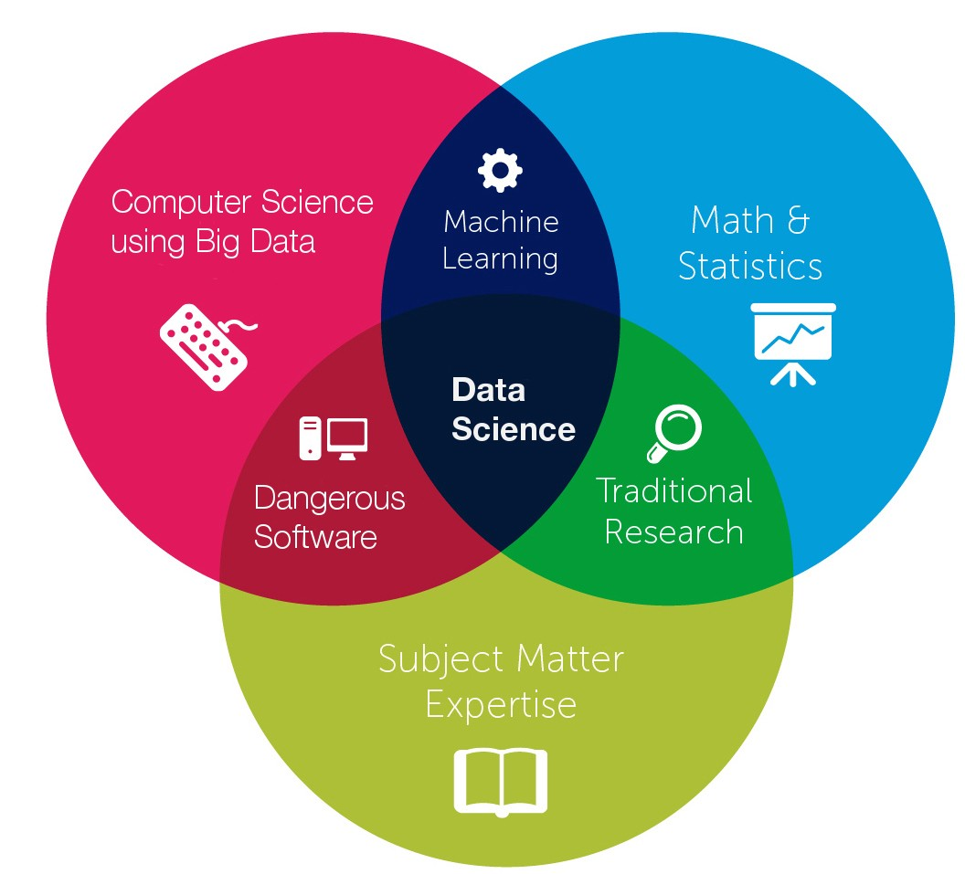
Project Team / Organization
Name | Title
Amber Martin | Project Manager
Karl Ramsay | Repository Manager
Oswaldo Moreno | Scrum Master
Ana Razak | Programmer Analyst
Anthony Brown | Programmer Analyst

Slide 4

Project Overview
SCOPE:
To complete a full data analysis of API data and CSV files to determine job availability, education level and salary potential of completing a Data Science boot camp.
OBJECTIVE:
To understand the career benefit of completing Data Science boot camp
Utilize the data results to make an educated decision on career path
Gain an understanding of how completion of a Data Science boot camp compares to a traditional Data Science degree in today’s job market
Project the financial benefit of salary increase potential

Slide 5
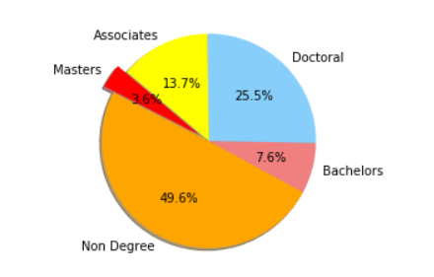
Let's Go to the Analysis!
We wanted to determine the education level of people who enroll in Data Science programs.
Utilizing StockOver 2019 survey data, we imported the data file into Jupyter Notebook with a pd.read function. By creating a data frame and then cleaning the data within the frame created; with the use of functions like .replace, .groupby and .append , we were able identify the education levels within scope.
Based on the results of the analysis 49.6% of the survey participants who completed a Data Science Bootcamp do not have a traditional data science degree. With data science credentials trending a such a fast pace in today’s market people are choosing to complete a bootcamp in order to remain marketable.

Slide 6
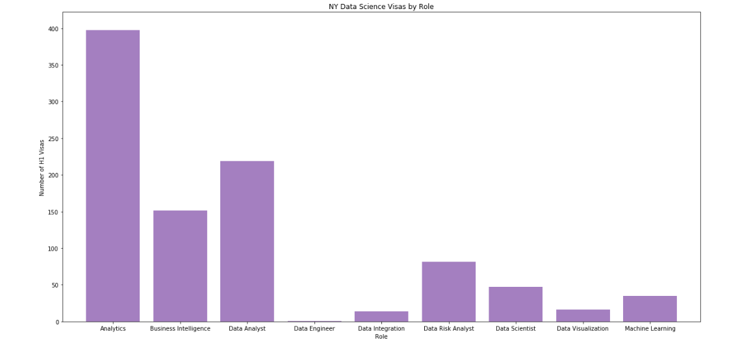
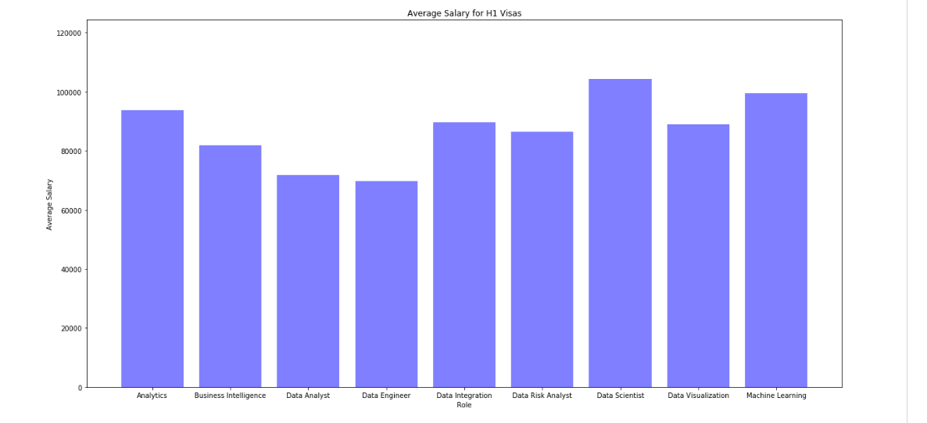
Let's Go to the Analysis!
We wanted to look at how many people with visas are working in the data science field to see how high the demand for people in the data science field is.
Using a VBA script, we prepped the csv file by creating two new columns called Role and Domain to filter out job titles using key word Data Science.. Then created a few groupby’s to get specific states we wanted to look at.
Then we wanted to look at the comparison in salaries for each job title. So made a bar graph comparing job titles to salaries and another bar graph comparing the number of H1B1 visas to job titles.

Slide 7
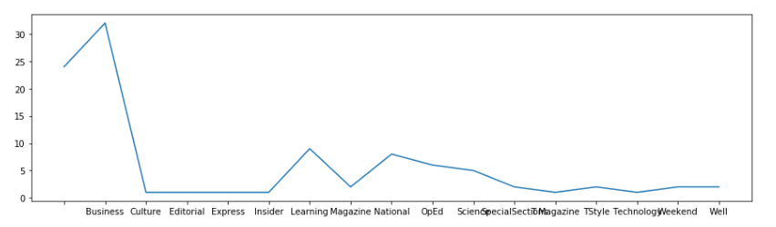
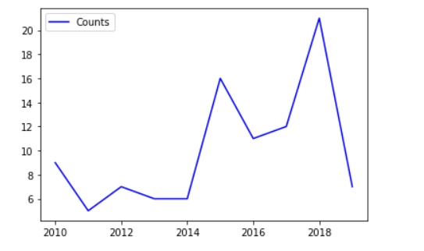
Let's Go to the Analysis!
Using the NY times API we wanted to see the past and current movement of increase data science popularity through a time series data analysis. Which involves the comparison of data over a specific period of time to spot a pattern or trend.
The NYT API key was used to pull raw data from the NYT server. Once we received the API key, with the 'machine + learning' query searched for articles within a 10-year time frame (Jan 2010- December of 2019). The returned articles from the search were appended into a lists.
The pd.DataFrame function along with key words were used to mine through and create a data frame. After mining through a first time, a smaller data frame was created with pd.Dataframe, groupby, rename, and count functions. This smaller data frame was then plotted into a time series data chart.

Slide 8
Resources
Tools | Components
VBA | FileDialog Range Offet Last Col Last row While Loop If Then Else
Python | Jupyter Notebook requests pprint NYTimes api pandas numpy matplotlib.pyplot os time Datetime
Git | Version Control Runbook Activity List Branching Cloning Repo Pulls Document Repository
Zoom | Video Conference Peer Coding Coding Reviews

Slide 9
Blockchain Brigade

